Slide 1
  VEEVA Product Metrics Configuration
LEVEL - PRACTITIONER

Slide 2
About the Author
Created By: | Subham Chowdhury, Supriyo Saha
Credential Information: | Associate – Projects; Sr. Consultant CRM – EAS Salesforce
Version and Date: | V1: 22-Jan-2018, V1.1: August-2023: Updated with Lightning UI
Modified By: | Abhijan Majumdar

Slide 3
Recap ...
In the previous Module - Products and My Setup, you learnt to:
  Review the Products Data Model
  Create and Configure Products:
    Product Catalog
    My Setup
    Detail Favorites
    Detail Topics
    Detail Groups
And now ...

Slide 4

Objectives
After completing this chapter, you will learn to:
  Define Product Metrics
  Define different types of Metric fields
  Configure Product Metrics section on Account profile
  Create a new Product Metrics
  Create Metric Configuration
  Explain how users can control Metric on Account Profile

Slide 5

Overview
Product Metrics are very important information in Life Sciences industry
Product Metrics are a set of attributes captured against each Accounts for each particular product
This information provides an insight into several aspects including prescribing habits of a Health Care Provider and other relevant information which are useful to users while recording Calls with an Account

Slide 6

Do You Know ... 1
Product Metrics in VEEVA contain information pertaining to Product specific attributes of an Account
There are five types of supported Product Metrics: Box picklist, Text picklist, Number, Arrows, Checkbox
The Product Metrics information in VEEVA is stored in the object named Product_Metrics_vod
Product Metrics information is displayed though an S-control named Ratings_vod which can be placed on any Account Page layout
Product Metrics can be enabled for Child Accounts

Slide 7
Do You Know ... 2
Adding a new Product Metric to an account profile is a 2-step process:
  Create new Custom Field in Product Metrics object
  Create Metric Configuration record for the new Product Metrics field
Users can have permissions to turn ON/OFF tabs while viewing the Product Metrics information on
Account profile

Slide 8
  Product Metrics

Slide 9
What are Product Metrics? ... 1
Product Metrics in VEEVA contain information pertaining to Product specific attributes of
an Account.
  For example, the Level of Adoption of a Product by an Account, the Segment in which an
  Account is placed with respect to a product, Formulary Status of an Account for a particular
  product and many more such information is displayed in the Product Metrics section in Account profile
Further, the prescribing habits of a Health Care Professional can also be based on the organization he/she is associated with
Hence VEEVA allows capturing Product Metric information at Child Account (Child_Account_vod_c) record level
This can help users to record the doctor’s position on products at a particular location and have that information available when recording a Call
With this feature user can view and update Product Metrics from the Child Account detail page

Slide 10
What are Product Metrics? ... 2
Different sales reps can view different attributes in the Product Metrics section in Account
profile
Users can only view Product Metric information for products (both Company and Competitor products) which are present in their My Setup
Users can also be allowed to update the various key product metrics for an account
Product Metrics can be defined for Detail Groups and Detail Topics in the same way they are used for Products

Slide 11
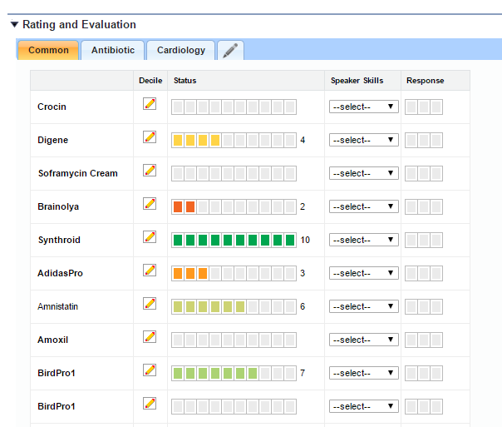
What are Product Metrics? ... 3

Slide 12
  Types of Metric fields

Slide 13
Product Metrics Field Types ... 1
There are five types of supported Product Metrics:
Box Picklist
  A visual indicator in form of boxes with colors ranging from red to green. This type of Product Metrics can be used to indicate progress along with text value
Text Picklist
  This type of Product Metrics can be used to display a text value. For example, Segment, Formulary Status etc. can be displayed using a Text Picklist metric
Number
  As the name suggests, this Product Metrics can be used to display a numeric value
© Cognizant 2023

Slide 14
Product Metrics Field Types ... 2
Arrows
  Up/Down or Horizontal arrows in 3 colors – red, yellow and green – are used to indicate change in numeric data
Checkbox
  A Checkbox Product Metrics can be used to display true/false information such as whether an Account is a Speaker for a particular product

Slide 15
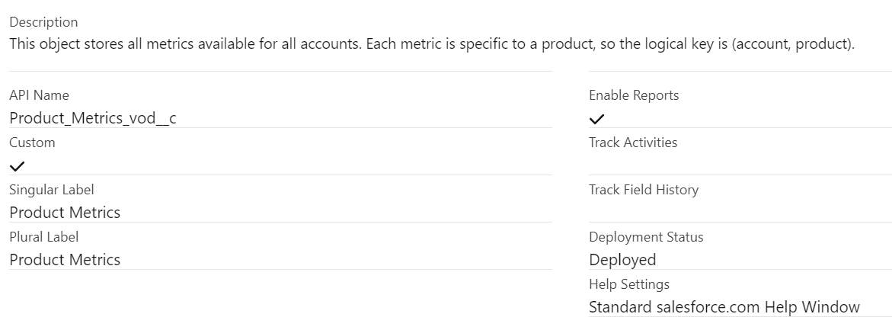
Product Metrics Object
The Product Metrics information in VEEVA is stored in the object named
Product_Metrics_vod
Product_Metrics_vod is a child object of the Account object, that is, it is placed at the detail end of a master-detail relationship with Account object
Data for the Product Metrics is stored in the Product_Metrics_vod custom object with one row for every account/product combination

Slide 16
Product Metrics Visibility ... 1
The visibility of Product Metrics in VEEVA is governed by the following:
  Product Metrics information is displayed though an S-control named Ratings_vod which
  can be placed on any Account Page layout
  FLS can be used to govern which Metrics information (field) will be visible to a user and whether it will be editable
  Product Metrics data can be accessed in Salesforce.com Reports module, through queries and can also be displayed on My Accounts page
  Accounts records in My Accounts list can be filtered using Product Metrics
  Users can only view Product Metric information for products (both Company and Competitor products) which are present in their My Setup

Slide 17
Product Metrics Visibility ... 2
  The No_Metrics_vod_c field on the Product_Catalog_vod object can be used if a company does not want to capture Product Metrics information for a product and hence does not want the product to be displayed in the Product Metrics section
  For company products, the Product Name in Product Metrics appears in bold (textual representation)

Slide 18
  Configuration of Product Metrics section on Account profile

Slide 19
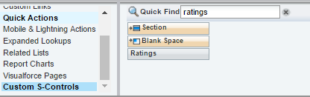
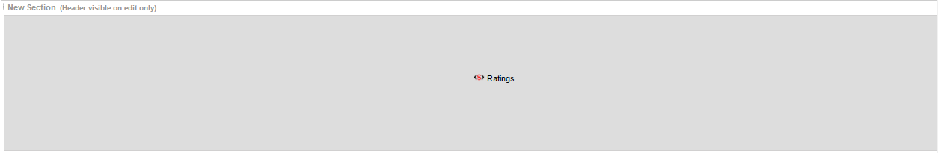
Account Layout Configuration
Display the Products Metrics section in Account page layout using the below steps:
  Create a new section in Account Page Layout with an appropriate name such as Ratings and Evaluations or Key Indicators or simply Product Metrics
  Place the s-control Ratings_vod in the section created in the above step

Slide 20
Configuring Product Metrics for Child Accounts ... 1
In order to enable Product Metrics for Child Accounts the below steps need to be performed:
  Navigate to Setup → Develop → Custom Settings → VEEVA Settings and click the Manage button
  Change the value of Enable Child Account (Enable_Child_Account_vod_c) checkbox to TRUE
  Provide users with FLS Read access to the following fields:
    Location_Parent_vod_c in Product_Metrics_vod_c object
    Location_Child_vod_c in Product_Metrics_vod_c object
    Location_vod_c in Product_Metrics_vod_c object
    zvod_Child_Account_Ratings_vod_c field in Child_Account_vod_c object

Slide 21
Configuring Product Metrics for Child Accounts ... 2
  Place the zvod_Child_Account_Ratings_vod_c field in Child Account page layout
  Update the Where clause in Product_Metric_vod VMOC with the following:
    WHERE (Account_vod_r.Name != null ) or (Location_vod_r.Child_Account_vod_r.Name != null and Location_vod_r.Parent_Account_vod_r.Name != null)

Slide 22
Product Metrics
Configuration

Slide 23
Creating a New Product Metric
Adding a new Product Metric to an account profile is a 2-step process
Create new Custom Field in Product Metrics object
Create Metric Configuration record for the new Product Metrics field

Slide 24
Custom Field in Product Metrics object ... 1
Create a new custom field in Product_Metrics_vod_c object by following the
below steps:
  Navigate to Setup → Create → Objects → Product Metrics
  Click the New button to create a custom field for your metric
    Choose the field type
    The following field types are supported:
      Checkbox
      Currency
      Number
      Percent
      Picklist

Slide 25
Custom Field in Product Metrics object ... 2
    Enter details of the new field. The help text for each field displays next to the corresponding column in the Ratings control and on the Product Metric Record Page Layout
    Set relevant FLS to control access to the field
    Add the field to page layouts if relevant. This step is not required to configure a new metric
    Click Save to create the new Metric field

Slide 26
Create Metric
Configuration

Slide 27
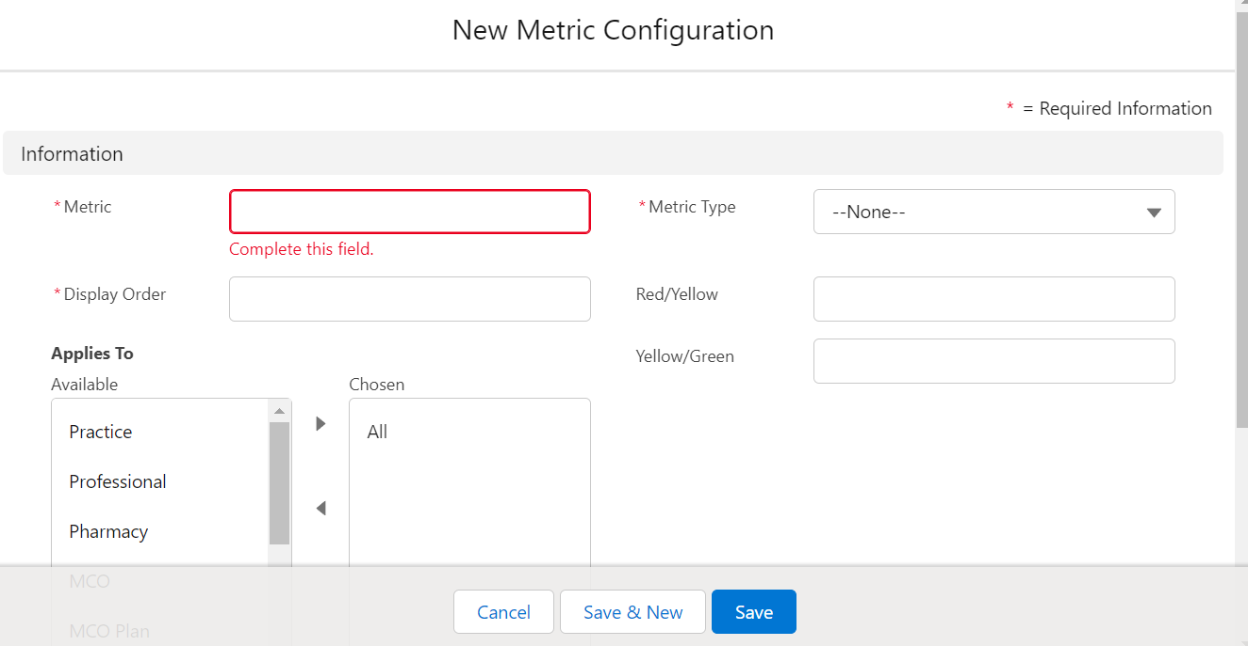
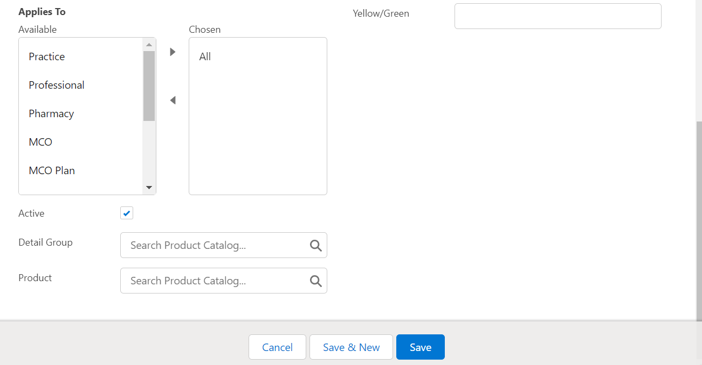
Create Metric Configuration ... 1
In order to display the new Product Metric custom field created, we will require to create a new record in Metric Configurations object to control the display of the field
Please follow below steps to create Metric Configurations record:
  Navigate to Metric Configurations Tab
  Click the New button to create a new record
  Provide value for the Name field of the Metric Configuration record
  This must exactly match with the API Name of the custom field created in the Product Metrics object. Please note that this field is case sensitive

Slide 28
Create Metric Configuration ... 2
  Enter the Display Order which is a numeric value in the Display Order field that
  corresponds to the order in which this metric is displayed
  In the Applies To field choose all Account record types for which this Product Metric will be applicable
  The Metric Type field defines what how the metric should be displayed – Box, Text, Number, Arrow, Checkbox
  Click Save to create a new Metric Configuration record

Slide 29
Create Metric Configuration ... 3
Please refer to the below table for mapping Product Metric field type to Metric Type
Metric Type | Product Metric Field Type
Box | Picklist
Text Picklist | Picklist
Number | Number, Currency, Percent
Arrow | Number, Currency, Percent
Checkbox | Checkbox
For Metric Type Arrows, please enter the threshold values as below:
  Enter a numeric value in Red/Yellow field. This value should be the one at which the arrow will change direction and color. Any value less than this threshold displays with a down red arrow
  In the Yellow/Green field, enter the numeric value. Any value greater than this threshold displays with a green up arrow
For any numeric value which falls between the above thresholds is displayed as a horizontal yellow arrow

Slide 30
Create Metric Configuration for Detail Group
Metric Configuration can be created for Detail Group as well. To do so follow the same
process as needed to create a Metric Configuration for a Product followed by the below step:
  Select Detail Group in order to enable the Metric for all Products associated to the Detail
  Group

Slide 31
Controlling Metric on
Account Profile

Slide 32
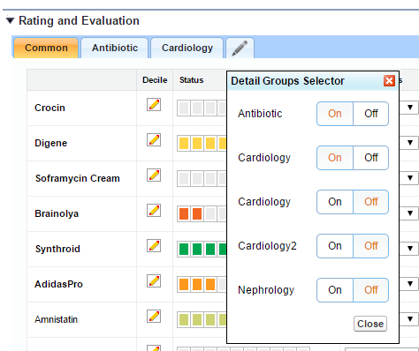
Metrics control in Account Profile
Users can turn ON/OFF tabs while viewing the Product Metrics information on Account profile
Clicking a tab displays the metrics for that particular Detail Group. Users can choose to display or remove a Tab from the Product Metrics section
However, the Common tab containing products not associated with a Detail Group is always displayed
In order to provide users with this permission the below steps need to be performed:
  Provide users with Create and Delete permissions on Product Metrics object
  Uncheck the Disable Edit Account Metrics Tab VEEVA Settings. If this value is TRUE, users cannot turn ON/OFF the Product Metrics tabs

Slide 33
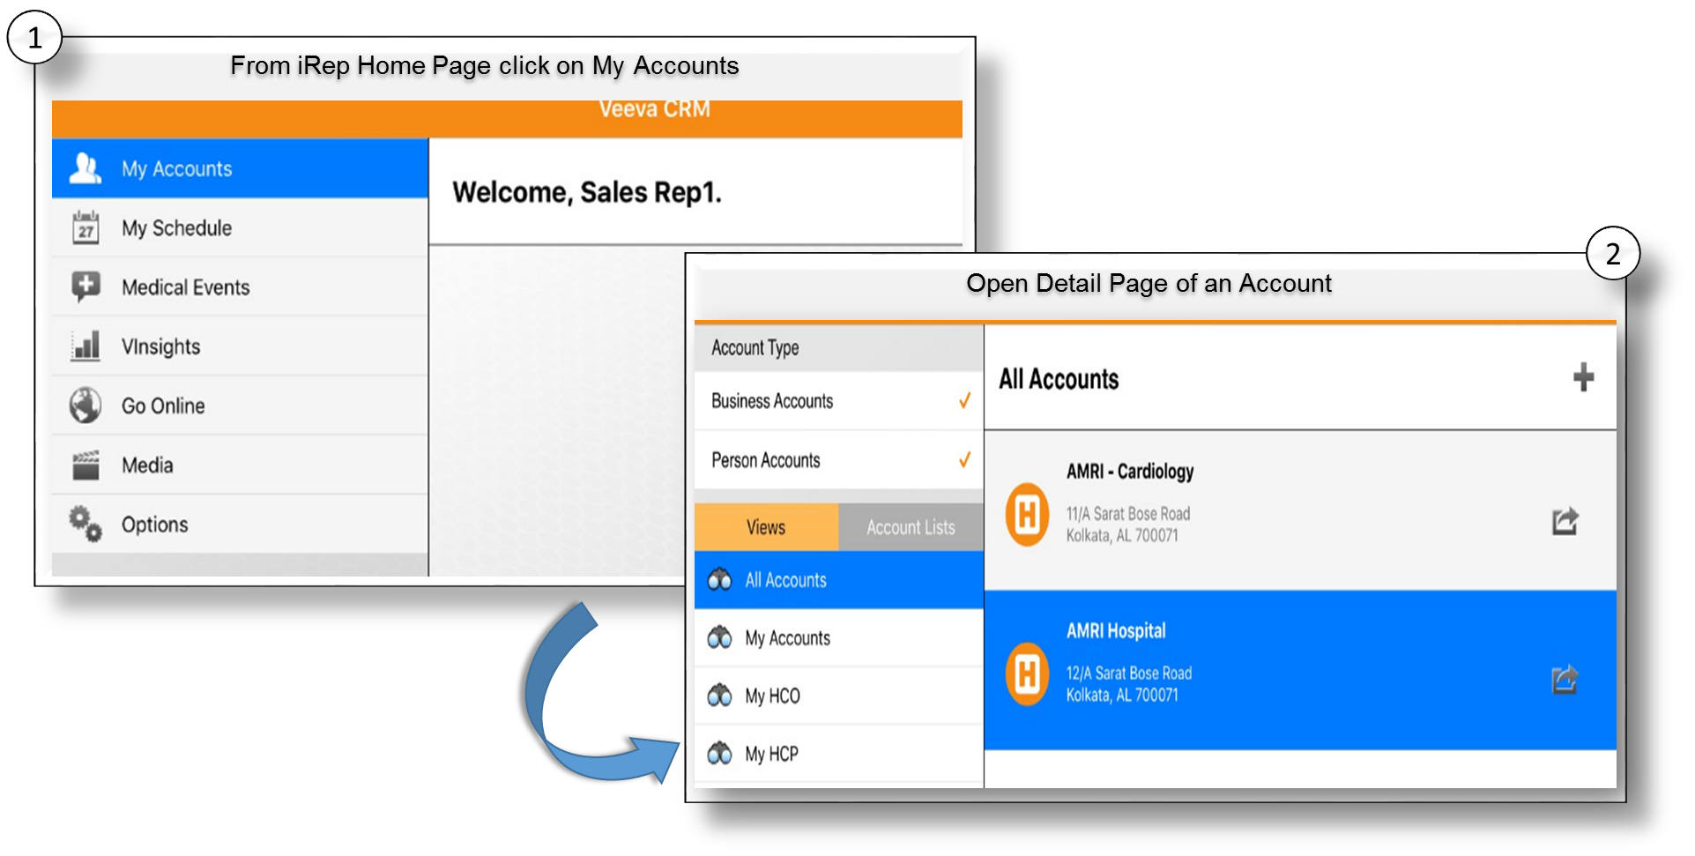
Product Metrics in iRep ... 1

Slide 34
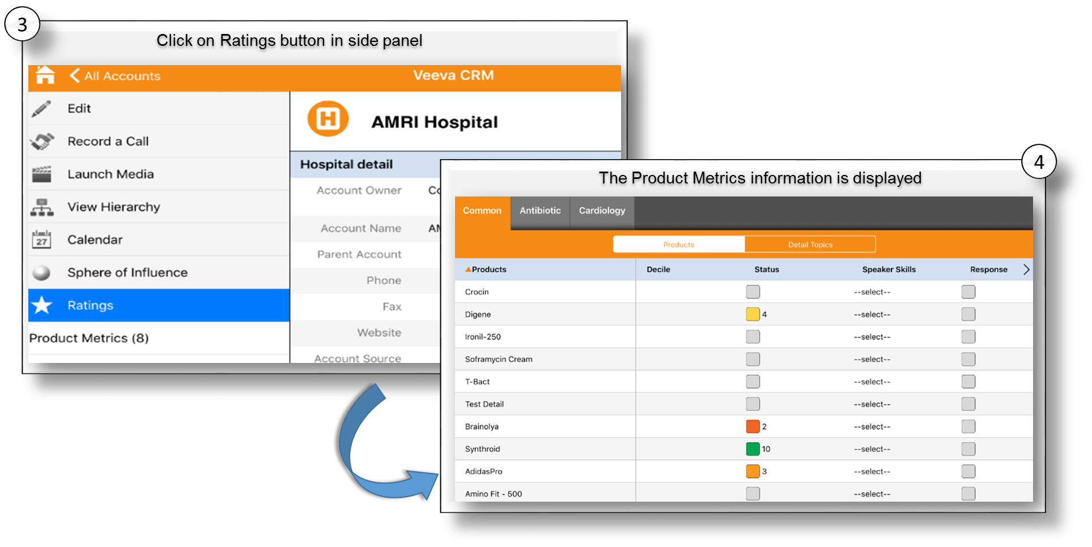
Product Metrics in iRep ... 2

Slide 35
Check Your Understanding ... 1
1. What are the types of supported Product Metrics?
Box Picklist
Text Picklist
Arrows
All of the above
Answer: All of the above
© Cognizant 2023

Slide 36
Check Your Understanding ... 2
2. Product Metrics information can be captured at Child Account level?
State True or False
True
False
Answer: True
© Cognizant 2023

Slide 37
Check Your Understanding ... 3
3. Name the s-control used to display Product Metrics in Account profile.
Product_Metrics_vod
Ratings_vod
Ratings_and_Evaluations_vod
None of the above
Answer: Ratings_vod
© Cognizant 2023

Slide 38
Check Your Understanding ... 4
4. Which of the following is not a supported field type for Product Metrics?
Checkbox
Text
Currency
Number
Answer: Currency
© Cognizant 2023

Slide 39
Check Your Understanding ... 5
5. Metric Configuration can be created for Detail Group as well.
State True or False
True
False
Answer: True
© Cognizant 2023

Slide 40

Summary
In this module, you have learnt to:
  Define Product Metrics
  Define different types of Metric fields
  Configure Product Metrics section on Account profile
  Create a new Product Metrics
  Create Metric Configuration
  Explain how users can control Metric on Account Profile

Slide 41

Source
https://crmhelp.VEEVA.com/doc/Content/Home.htm
https://trailhead.salesforce.com/en/home
Disclaimer: Parts of the content of this course is based on the materials available from the Web sites and books listed above. The materials that can be accessed from linked sites are not maintained by Cognizant Academy and we are not responsible for the contents thereof. All trademarks, service marks, and trade names in this course are the marks of the respective owner(s).

Slide 42
Coming Next ...
In the upcoming module - Online Application UI settings, you will learn about:
  Overview of Call Data Model
  Review Marker Fields and Section Signals
  Define call page layout sections including:
      Call Attendees
      Product Details
      Key Messages
      Pre and Post Call Notes
  Configure call page layout assignment
  Restrict and default Call types by Account record types

Slide 43
Thank you
  You have successfully completed
  VEEVA Product Metrics Configuration

